Slide 1
Densest Subgraph Discovery on the GPU
Hunter Gareau Thesis Defense

Slide 2
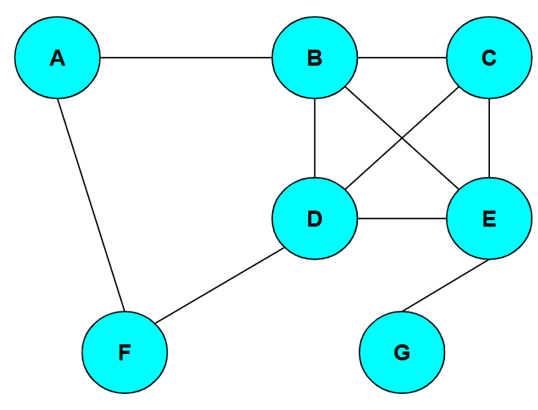
Graphs and Graph Mining
Graphs are a way of representing connections and relationships in data subjects.
They are composed of vertices and edges. Edges can be directed but we will be using undirected graphs.
They can represent data from social networks to neural networks to power grids.
The analyzation of graphs to find patterns and information is called Graph Mining.

Slide 3
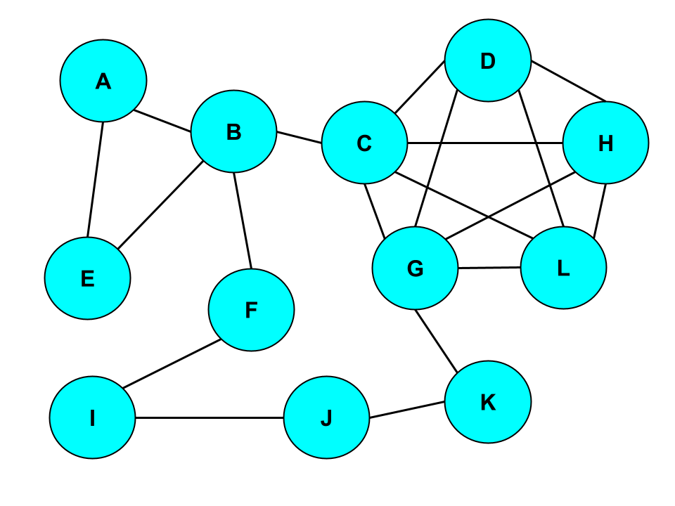
Graph Example
As an example, say this graph is a representation of different Facebook groups, with the vertices being these groups and the edges representing that the two groups share an administrator.

Slide 4
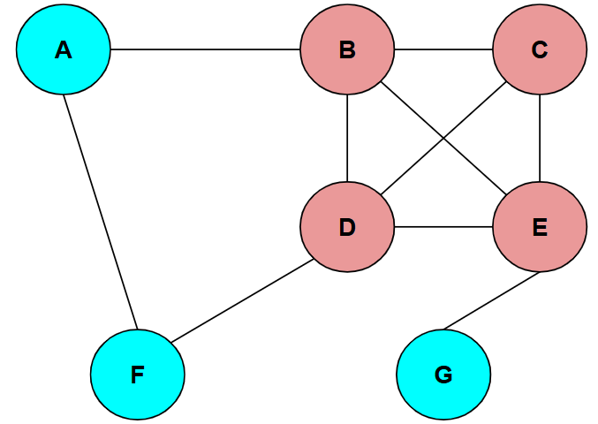
Densest Subgraph Discovery Problem
One fundamental Graph Mining problem is the Densest Subgraph Discovery Problem (DSD).
Edge density is the ratio of edges to vertices in a given graph.
The DSD aims to find the subgraph of highest density in a given graph.
The densest subgraph has various uses depending on what the graph represents.

Slide 5
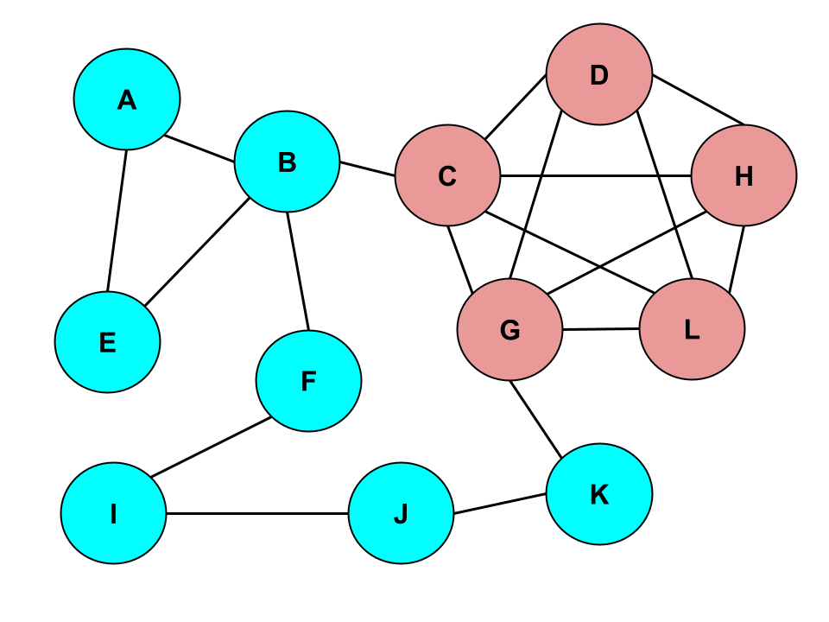
Densest Subgraph Application
Returning to our Facebook group graph, an example use of the DSD is that by finding the densest subgraph in this example, we’ve identified a potential echo chamber.

Slide 6
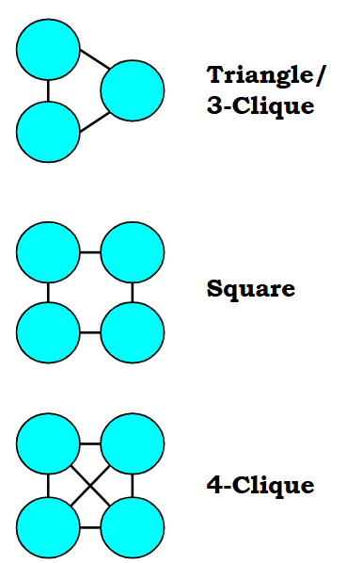
Cliques, Motifs, and Clique Density
Motifs are small subgraphs of a specific edge layout (such as triangles, squares, 4-paths, etc.), which are useful for examining more patterns and types of connections.
Cliques are a specific type of motif, where every vertex in the miniature subgraph is connected to one another.
Motif/Clique density is the ratio of motif or clique instances to the number of vertices in a subgraph.
Because edges are covered under motif/cliques (as 2-cliques), we will be using motif/clique density for our purposes.

Slide 7
Parallel Programming
Many solutions to the DSD exist, however they are serialized algorithms. This can get taxing quickly for Graph Mining programs when handling vertices and edges one at a time in large graphs/data sets.
By running in parallel, many vertices or edges can all be handled at once and cut down on runtime.
Serialized programs run entirely on the CPU (Central Processing Unit), but parallel programs often utilize the GPU (Graphics Processing Unit).

Slide 8
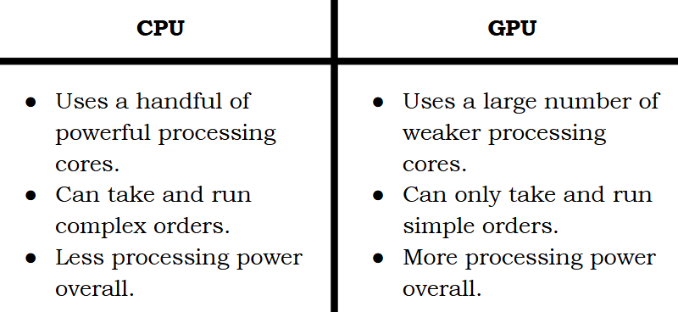

Slide 9
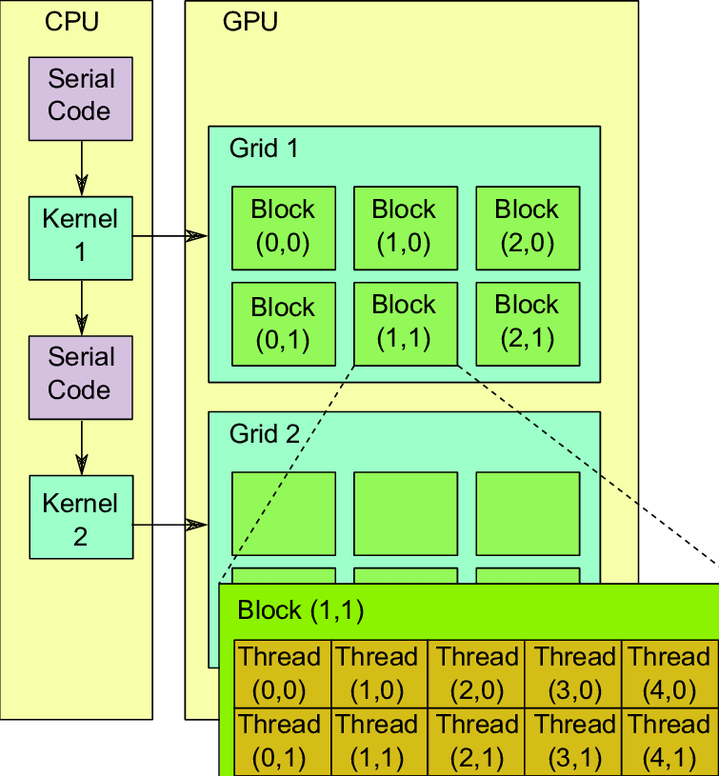
GPU Structure
It is important to understand the basic structure of the GPU to use it effectively.
Processes and commands are run on Threads (a unit of execution).
Threads are a hierarchal structure, and data is more costly to share between levels.
32 threads make up a Warp. The instructions are the same between threads in a warp.
Some number of warps make up a Block (the number depends on the GPU).
Final level is Grids, made up by blocks. When a kernel (parallel process) is launched, it is mapped to the processors of a grid.

Slide 10
CUDA by NVIDIA
Writing a program entirely in the simple language available to the GPU would be extremely difficult.
CUDA (Compute Unified Device Architecture) is a tool created by NVIDIA that allows programs written in the serial language C++ to execute kernels on the GPU and access the results of these kernels.
This effectively allows for more complex programs to switch between the CPU and GPU as needed.

Slide 11
Our Goal
The goal of this research project was to adapt an algorithm that solves the DSD to a parallel CUDA program.
This serves two purposes: creating a more efficient solution to the DSD and serving as further research into the efficacy and computational power of parallel programming.

Slide 12
Existing Solutions
The first necessary step was deciding on an algorithm to adapt. Many exist due to the prevalence of the DSD.
A highly important one is Goldberg’s Maximum Flow algorithm (which will be covered later). This is an exact solution to the DSD, but there are quicker algorithms that approximate the solution.

Slide 13
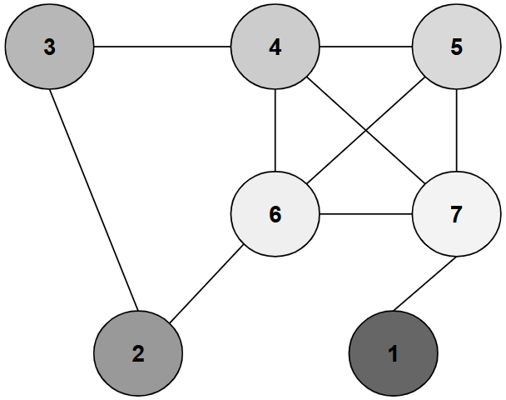
Greedy Peeling and Greedy Peeling++
A famous approximation algorithm by Moses Charikar is the Greedy Peeling algorithm, which finds the vertex with the least number of connections (referred to as degree), and removes it. By checking the density of the graph after each peel, you can keep track of which subgraph was densest.
Greedy++ is an algorithm that builds on this. By running the Greedy algorithm multiple times and assigning priority to each vertex based on when it is removed, an even denser subgraph can be found given enough iterations.

Slide 14
Related Works
Before we continue, I’d like to highlight some similar problems to the DSD and existing solutions to them.
One variation of the DSD is the Densest k-Subgraph problem, where the goal is to find the densest subgraph of size k. One such solution to this approximates this by taking the subgraph of only the top k/2 vertices with the highest degree.
Another variation of the DSD is for directed graphs, where the density definition is changed to reflect direction from one subgraph to another. An exact solution to this was created by Charikar which finds the optimal solution to a linear programming problem based on the ratio of the sizes of the subgraphs.
The final variation I’ll mention is the Optimal Quasi-Clique Problem, which uses the edge surplus definition instead of density to favor subgraphs with a shorter diameter. One solution to this is a variation of the greedy peeling algorithm.

Slide 15
CoreExact
After deliberating over many of the existing DSD solutions, the one we settled on parallelizing was the CoreExact algorithm from the paper “Efficient Algorithms For Densest Subgraph Discovery”.
To put it simply, this algorithm uses various methods to trim down the input graph before breaking it into smaller parts and running Goldberg’s exact algorithm on each piece.
There is a lot to unpack to understand the parallelization of CoreExact, so first we will cover important concepts and parts of how the original CoreExact algorithm works.

Slide 16
Pruning and Decomposition
The first major step of CoreExact is pruning down the input graph. Smaller graphs are processed more quickly, so reducing the input graph to a smaller graph (or graphs) will make the search for the densest subgraph quicker.
This is done in two main steps, finding the densest k-core and breaking that down into connected components.

Slide 17
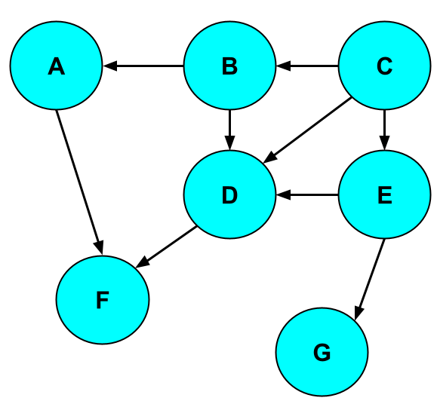
DAG (Directed Acyclic Graph) Generation
Before the algorithm can start, every motif/clique instance must be found. Finding edge-based degrees of all vertices is also necessary, but the runtime is negligible.
To do so, a DAG (directed acyclic graph) must be constructed. Finding motifs requires branching down all possible paths, meaning loops would cause issues. But DAGs are designed to have no loops.
In CoreExact, the DAG design is such that all edges are now directed from higher core value to lower core value (with those of the same core value being determined by the order they were removed during edge decomposition).

Slide 18
Finding All Motifs in the Graph
The process for finding motif/clique instances is done recursively.
All paths of size k (where k is the size of the motif/clique) are checked, storing path information down each iteration until k = 2.
At that point, every neighbor is checked to see if they complete the motif/clique, and if they do, that information is updated (it’s added to the list, the number of motifs/cliques is updated, the motif/clique degree of each vertex is updated, etc.).
With this information, we can find the densest k-core.

Slide 19
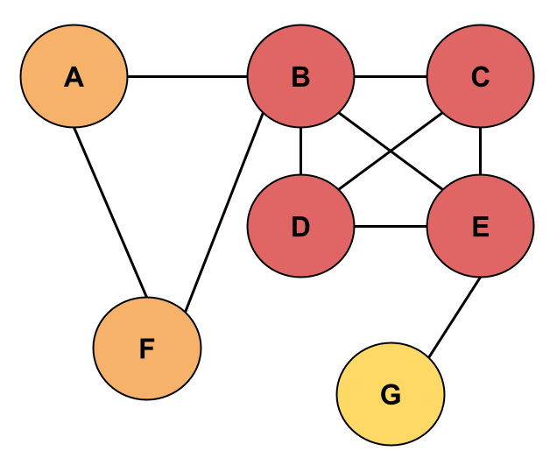
k-cores
A k-core is a graph where every vertex has a degree of at least k (is connected to at least k other vertices).
Subgraphs within a given graph can be of a higher k-core level. The core value of a vertex is the highest-level k-core they are part of in the graph.
Core values and every level k-core can be found by pruning a graph one vertex at a time, removing the vertex of lowest degree each iteration.
The example on the right uses edge degree.
Yellow = 1-core
Orange = 2-core and lower
Red = 3-core and lower

Slide 20
k-cores
Degree (and thus k-cores) is also used for motifs/cliques. So, the amount of motif instances a vertex is a part of is the degree of that vertex.
As an example, 3-clique (or triangle) degree is how many 3-cliques a vertex is a part of.
The example on the right uses 3-cliques for determining k-cores.
Yellow = 0-core
Orange = 1-core and lower
Red = 3-core and lower

Slide 21
Motif/Clique Decomposition
The process for motif/clique core decomposition is basically the same as the greedy peeling algorithm, just using motif/clique-based degrees.
At each step, the vertex of lowest motif/clique degree is identified, then removed from the graph.
With each removal, the core value of that vertex is stored.
A running “densest k-core” is also stored and updated when the level of the k-core increases (e.g. going from 1-core to 2-core) and that k-core has a higher density.
Yellow = 0-core
Orange = 1-core and lower
Red = 3-core and lower

Slide 22
Why The Densest k-core?
The reason we find the densest k-core is that it was proven that it contains the densest subgraph (of the input graph).
A lemma states that from the densest subgraph with density p, removing a vertex will result in at least ⌈p⌉ motifs/cliques being removed from the subgraph. This was proven by contradiction, since if it was less than ⌈p⌉ motifs/cliques, the density after removal would be higher.
Intuitively, this means that any vertex in the densest subgraph has a degree of at least ⌈p⌉ (is in at least ⌈p⌉ motifs/cliques).
This definition matches a k-core, where any vertex in the k-core has a degree of at least k. Therefore, we can conclude that the densest subgraph is in the k-core where k = ⌈p⌉.

Slide 23
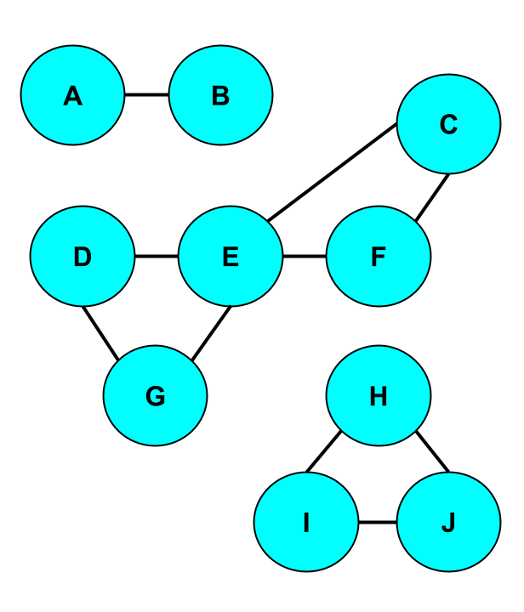
Connected Components
To take the decomposition even further, we then break the densest k-core into its connected components.
Connected components are disjointed subgraphs of a larger graph, where each subgraph is only of vertices that are connected by some path through the graph.
This is done because connected components will be denser apart than together considering the many vertices that aren’t connected to each other.
Connected Components: {A, B}, {C, D, E, F, G}, {H, I, J}

Slide 24
Summary of the Pruning and Decomposition of CoreExact
The big steps of CoreExact so far are:
1. Finding edge-based degree of all vertices (negligible runtime).
2. Generating the DAG.
3. Finding all motif/clique instances and the degree of every vertex.
4. Motif/clique core decomposition to find the densest k-core.
5. Splitting the densest k-core into its connected components.

Slide 25
Finding the Densest Subgraph
To find the densest subgraph, CoreExact runs Goldberg’s maximum flow-based algorithm on each connected component, keeping track of the densest subgraph found (with the starting densest subgraph being set as the densest k-core).
So now, we must cover how Goldberg’s algorithm works to understand the parts that were parallelized.

Slide 26
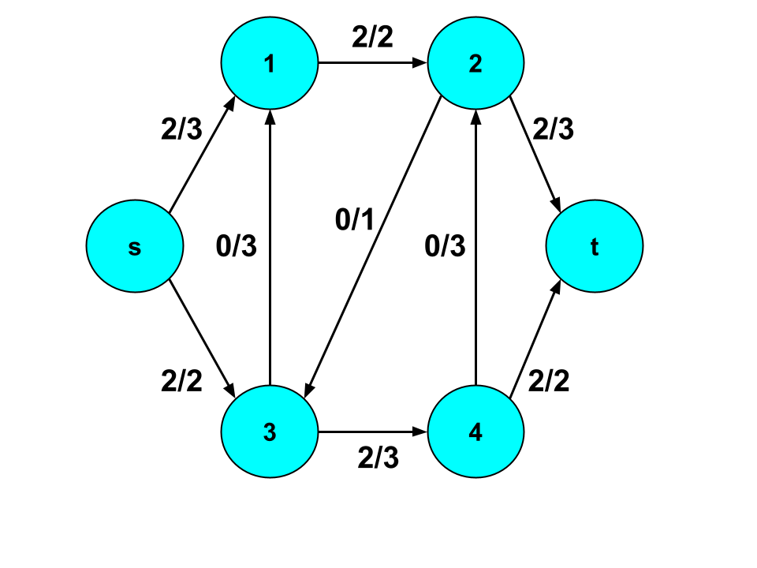
Flow Networks
To understand Goldberg’s exact algorithm, a few concepts need to be covered first.
Flow networks are a special type of directed graph where edges have flow (some amount of “something” pushed through the edge). Each edge has a capacity (a maximum flow). This is often represented as x/y, where x is flow and y is capacity.
In a flow network, there are two special nodes called the source and sink. Flow only comes out of the source and only flows into the sink.

Slide 27
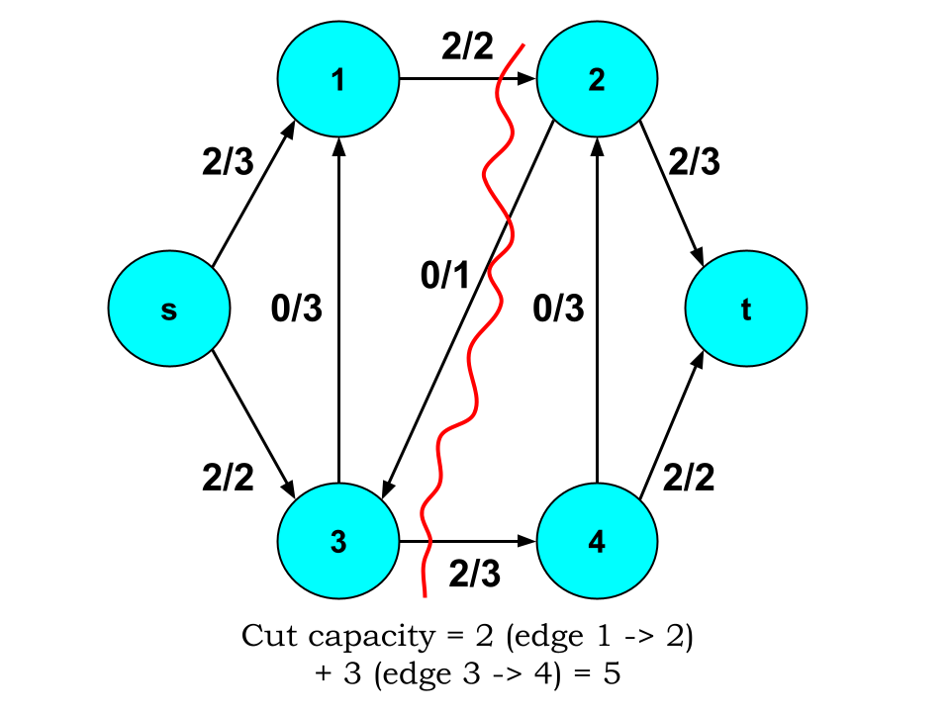
st-cuts
An st-cut is the division of a flow network into two disjointed subgraphs S and T, where S contains the source and T contains the sink.
This cut is made by removing edges until no connection between the subgraphs remains.
The cut capacity of an st-cut is the total sum of the capacities of the cut edges that flowed from S into T.

Slide 28
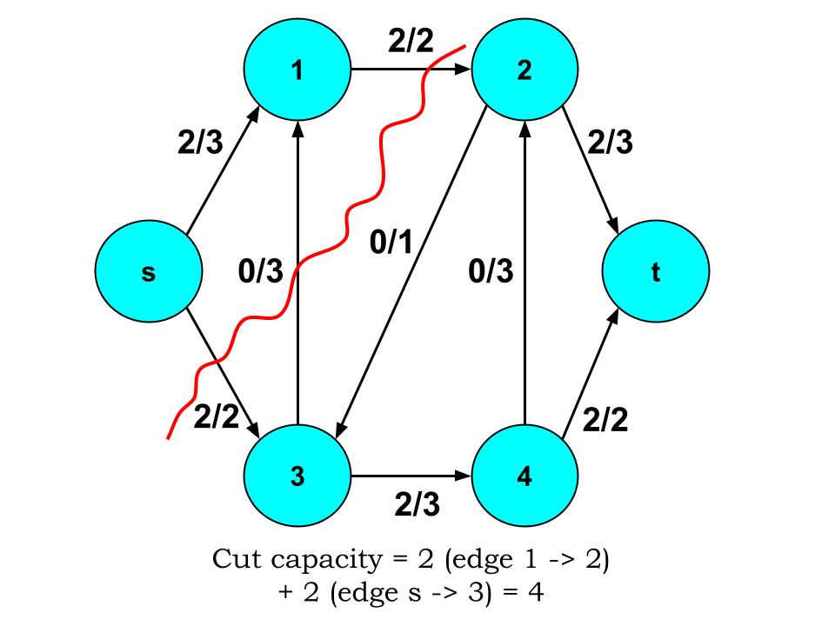
Minimum st-cuts
The minimum st-cut is the st-cut where the cut capacity is minimized.
Importantly, it has been proven that the minimum st-cut value is equal to the maximum flow through the flow network. This means finding one value helps find the other.
In Goldberg’s algorithm, finding the minimum st-cut is an important step, and a Breadth First Search that pushes as much flow down every path possible is used to find the maximum flow. And by taking the st-cut of this max flow graph, the minimum st-cut is found.

Slide 29
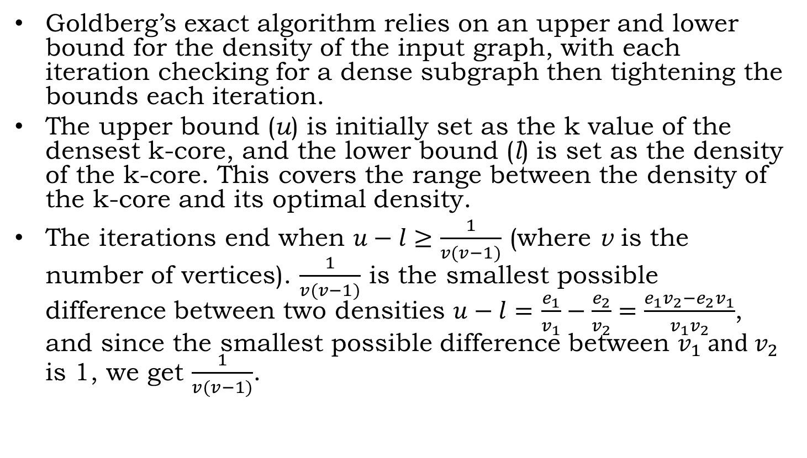
Goldberg’s Maximum Flow-Based Algorithm
Goldberg’s exact algorithm relies on an upper and lower bound for the density of the input graph, with each iteration checking for a dense subgraph then tightening the bounds each iteration.
The upper bound (u) is initially set as the k value of the densest k-core, and the lower bound (l) is set as the density of the k-core. This covers the range between the density of the k-core and its optimal density.
The iterations end when $u−l≥\frac{1}{v(v−1)}$ (where v is the number of vertices). $\frac{1}{v(v−1)}$ is the smallest possible difference between two densities $u−l=$ $\frac{e_{1}}{v_{1}}−\frac{e_{2}}{v_{2}}=\frac{e_{1}v_{2}−e_{2}v_{1}}{v_{1}v_{2}}$, and since the smallest possible difference between $v_{1} and v_{2}$ is 1, we get $\frac{1}{v(v−1)}$.

Slide 30
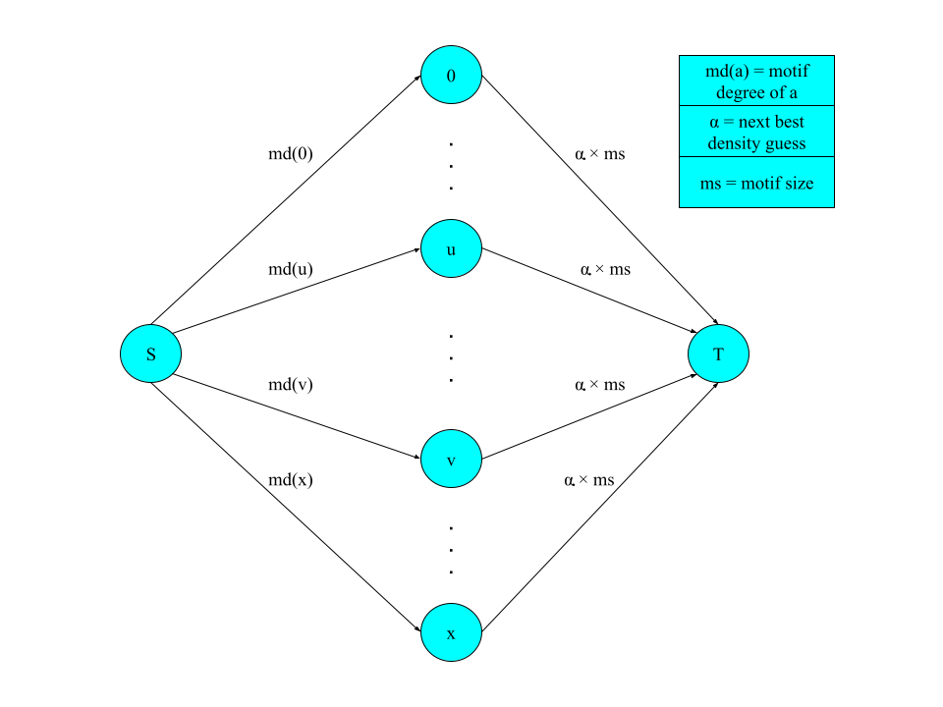
Goldberg’s Maximum Flow-Based Algorithm (continued)
As stated, bounding aside each iteration of the algorithm checks for a dense subgraph. The density check for is the average of u and l, represented as α.
To try and find a subgraph of density α, a particular flow network is constructed, as seen on the right.
Of note, while not depicted, the edges connecting the original vertices (0 -> x) are replaced by directed edges going both ways with a capacity of 1 each.

Slide 31
Goldberg’s Maximum Flow-Based Algorithm (continued)
With this flow network, Goldberg proved that if you take the minimum st-cut and look at the subgraph S / {s} (all vertices in S but the source), this subgraph will be of density α or higher (but if the subgraph is empty no such subgraph exists).
So, with each iteration, there are two cases. If a denser subgraph is found (α or higher), the lower bound is set to α. If not, the upper bound is set to α.
Additionally, the flow network is updated to adjust for the new α value.

Slide 32
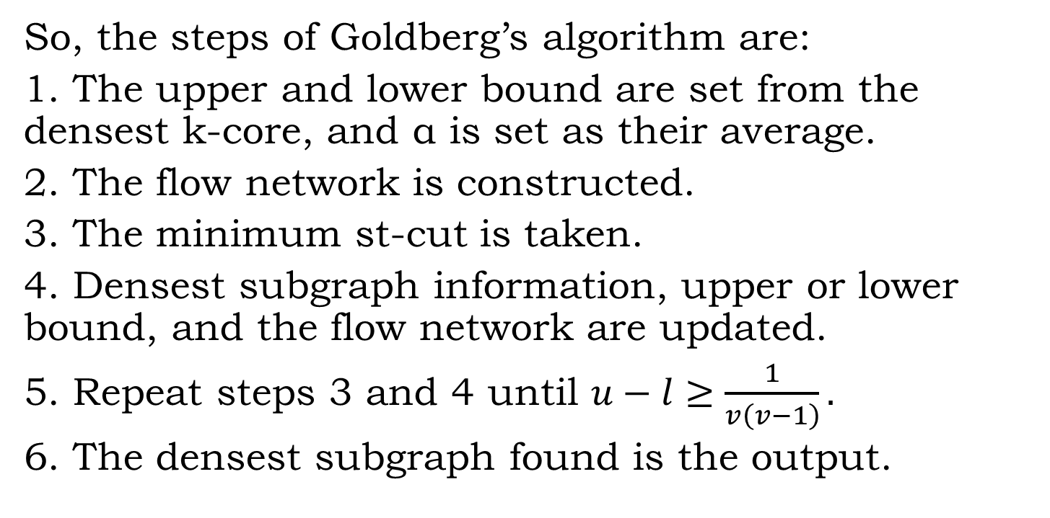
Goldberg’s Maximum Flow-Based Algorithm In Summary
So, the steps of Goldberg’s algorithm are:
1. The upper and lower bound are set from the densest k-core, and α is set as their average.
2. The flow network is constructed.
3. The minimum st-cut is taken.
4. Densest subgraph information, upper or lower bound, and the flow network are updated.
5. Repeat steps 3 and 4 until $u−l≥\frac{1}{v\left(v−1\right)}.$
6. The densest subgraph found is the output.

Slide 33
CoreExact in Summary
The major steps of the CoreExact algorithm are:
1. Running motif/clique-based decomposition on the input graph to find the densest k-core.
2. Splitting the k-core into its connected components.
3. Running Goldberg’s algorithm on each component.
All the while the information on the densest subgraph is kept track of between iterations.

Slide 34
Parallelization
With CoreExact covered, we can explain how it was parallelized.
Of note, not all of it was parallelized. This was due to either time constraints or sections of the code not being able to work in parallel (such as minimum st-cuts being too reliant on consecutive dependencies).
Additionally, while CoreExact worked for all motif types, not every motif type could be checked in parallel, so our solution is limited to clique density.

Slide 35
A Reminder of Hierarchal GPU Structure
Threads make up warps.
Warps make up blocks.
Blocks make up grid.
This grants versatility in how parallelization occurs (can be multilayered).
Sticking to lower levels of the hierarchy (threads < warps < blocks) in parallelization makes data transfers less costly.

Slide 36
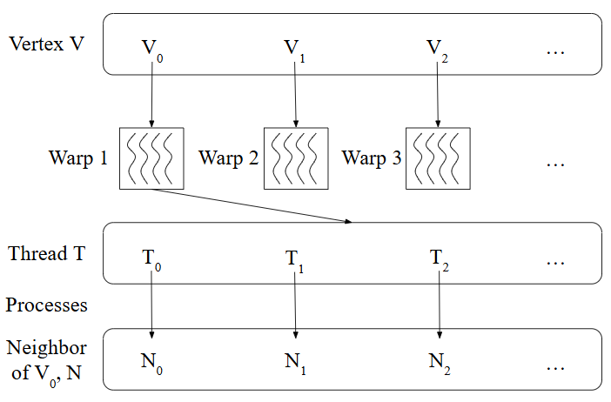
DAG Generation
Edge based decomposition is negligible and done before this.
The first big step is generating new DAG degrees, which only account for the neighbors a vertex points to (higher core to lower core). The vertices are all handled by warp, with each thread of the warp processing the neighbors of the vertex.
Step two is creating an adjacency list to represent the graph. This follows the same parallel structure as step one, with each thread processing a neighbor and adding it to the warp vertex’s array if the neighbor has a lower degree.

Slide 37
Listing All Cliques
The first step here is finding all pairs of vertices that are could be part of a k-clique. This handles vertices by warp and their neighbors by thread. For each pair, if both have a degree of at least k the pair is added to the list of clique candidates.
Once the candidates are determined, a loop iterates down each k level (k-1 each iteration) until k=2.
During each iteration, the candidates are handled by warp. Each thread checks a neighbor, and if it has at least k neighbors with the other vertices in the clique candidate, the original candidate plus that vertex are added as a new candidate.
The final step handles the candidates by warp and the neighbors by thread again. For every neighbor that is connected to each vertex in the candidate, a complete clique is found and stored.

Slide 38
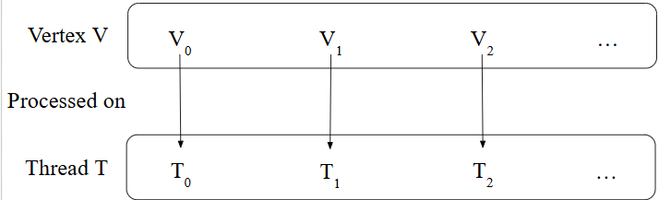
Clique-Based Core Decomposition
The parallelization of this occurs in a serial loop, which checks each k-core level (0-core, 1-core, etc.) until all vertices have been peeled.
The first parallelized part is identifying all vertices that are only part of the current k-core. This handles all vertices by thread. For each thread, if the degree of the vertex equals k, it is added to the buffer of vertices to be peeled.
The second step handles every vertex in the removal buffer by warp. Each clique of the vertex is checked, handling the neighbors of the vertex in that clique by thread, decreasing the clique degree of that neighbor by 1. If the degree is decreased to the current k level, that neighbor is added to the removal buffer for next iteration. If the degree goes below the k level, it is incremented by 1 so that the list of degrees holds core values by the end. This process runs until all vertices in the removal buffer are peeled.

Slide 39
Component Decomposition
For finding connected components, the vertex numbers are copied and used to be component ids. The goal is to find the minimum id each vertex is connected to via some path through the graph.
This is done in parallel by handling vertices by warp, and their neighbors by thread. Each thread checks if the vertex has a neighbor with lower component id, and if it does, the vertex id is updated to that.

Slide 40
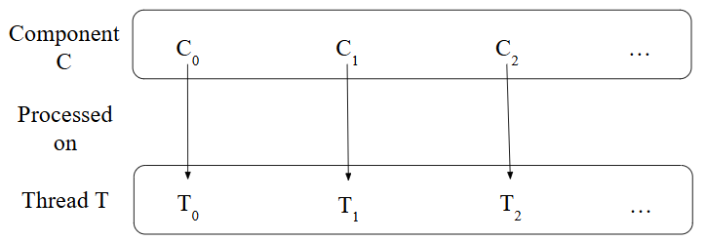
Bound Generation
While Goldberg’s exact algorithm wasn’t fully parallelized, two big parts of it were.
First is generation of the upper and lower bounds. This will be different for each component, and the data will be stored in an array.
Each component is handled by a separate thread. The lower bound is set as the component’s density. The upper bound is set as whatever is lower between the densest k-core level and the optimal density of that component.

Slide 41
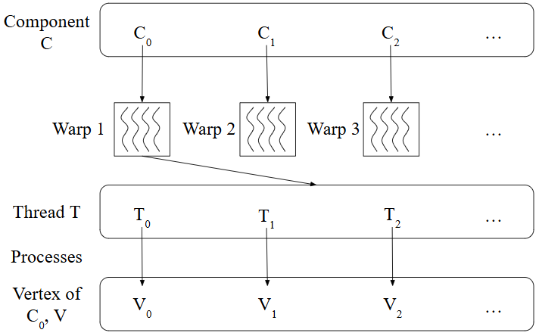
Flow Network Creation
The final part parallelized is creation of the flow networks for Goldberg’s algorithm.
The components are handled by warp and its vertices are handled by thread.
The flow network is stored as two linked arrays, one that stores the edges and one that stores the capacities of those edges.
For each thread, an edge from the source to the vertex is created and given capacity equal to the vertex’s degree, and an edge from each vertex to the sink is created with capacity equal to α times clique size.

Slide 42
Parallelization Summary
So, the main parts of CoreExact that were parallelized include:
DAG generation.
Listing all k-clique instances.
Clique-based core decomposition.
Component decomposition.
Bound generation.
Flow network creation.

Slide 43
Testing The Program
With the program created, testing the parallelized solution was the final step.
To check its efficiency, we ran it against the original CoreExact algorithm (written in Java).
In theory, the CUDA program should handle large graphs and graphs with more connected components more efficiently due to vertices and components being handled across threads and warps.

Slide 44
Test Data
The data will be run on both programs and will run based on edge (2-clique) and triangle (3-clique) density.
8 different graphs were used for the experiments.
3 are real data, being graphs that represent a network of the proteins in yeast, a social network of European users for the music streaming platform Deezer that are friends, and a network of authors on scientific papers that have co-authored together before.
5 are synthesized graphs, with varying probability of connections between any two pairs.

Slide 45
Test Data (continued)
Highest Density Subgraph by Graph (rounded to 2 decimal points)
Vertex and Edge Number by Graph
Graph | Number of Vertices | Number of Edges
Yeast Protein Network | 1,459 | 1,948
European Deezer Social Network | 28,281 | 92,752
Condense Matter Co-Author Network | 108,300 | 186,936
Synthetic Graph 1 | 500 | 6,276
Synthetic Graph 2 | 500 | 12,372
Synthetic Graph 3 | 1,000 | 25,053
Synthetic Graph 4 | 2,500 | 31,256
Synthetic Graph 5 | 5,000 | 12,385
Graph | Highest Edge Density (edges / vertices) | Highest 3-Clique Density (3-cliques / vertices)
Yeast Protein Network | 2.26 | 3.71
European Deezer Social Network | 8.53 | 33.41
Condense Matter Co-Author Network | 13.37 | 109.63
Synthetic Graph 1 | 12.55 | 5.23
Synthetic Graph 2 | 24.74 | 40.67
Synthetic Graph 3 | 25.05 | 20.80
Synthetic Graph 4 | 12.51 | 1.21
Synthetic Graph 5 | 2.62 | 0.33

Slide 46
Experiment Results
Graphs by DSD Runtime Over Edge Density
Graphs by DSD Runtime Over 3-Clique Density
Graph | CoreExact Runtime (milliseconds) | Parallelized Solution Runtime (milliseconds) | Speed Increase (CoreExact Runtime/ Parallel Runtime)
Yeast Protein Network | 403 | 153.368 | 2.63
European Deezer Social Network | 23545 | 9893.91 | 2.38
Condense Matter Co-Author Network | 76683 | 1558.99 | 49.19
Synthetic Graph 1 | 16875 | 443.164 | 38.08
Synthetic Graph 2 | 59243 | 3045.69 | 19.45
Synthetic Graph 3 | 228629 | 1344.22 | 170.08
Synthetic Graph 4 | 1021662 | 4312.55 | 236.9
Synthetic Graph 5 | 278561 | 9916.88 | 28.09
Graph | CoreExact Runtime (milliseconds) | Parallelized Solution Runtime (milliseconds) | Speed Increase (CoreExact Runtime/ Parallel Runtime)
Yeast Protein Network | 114 | 131.444 | 0.87
European Deezer Social Network | 6346 | 18177.1 | 0.35
Condense Matter Co-Author Network | 108521 | 3347.62 | 32.42
Synthetic Graph 1 | 9365 | 317.121 | 29.53
Synthetic Graph 2 | 1187069 | 433087 | 2.74
Synthetic Graph 3 | 1566331 | 53334.22 | 29.37
Synthetic Graph 4 | 12231 | 7693.51 | 1.59
Synthetic Graph 5 | 291 | 254.143 | 1.15

Slide 47
Conclusion
While not fully consistent depending on the input data, overall, there was a very notable decrease in runtime from the serial program to our parallelized program. Thus, we can conclude that the CUDA solution was overall more efficient.
This reaffirms the computing power available through the GPU and CUDA, presenting a powerful source for creating faster and more efficient programs.
With more time, our CUDA solution to the DSD could become more efficient, but as it stands, it is an effective and efficient solution to the DSD and serves as an example of what can be achieved with parallel programming on the GPU.

